Slide 1

VISION
LOSING SIGHT TO
GAIN VISION

Slide 2
“The only thing worse than being blind is having sight but no vision”
Helen Keller

Slide 3
A self-derived vision of a saved man is no better than a self-derived vision of a lost man’s vision

Slide 4

Acts 9:3-6 And as he journeyed, he came near Damascus: and suddenly there shined round about him a light from heaven: 4 And he fell to the earth, and heard a voice saying unto him, Saul, Saul, why persecutest thou me? 5 And he said, Who art thou, Lord? And the Lord said, I am Jesus whom thou persecutest: it is hard for thee to kick against the pricks. 6 And he trembling and astonished said, Lord, what wilt thou have me to do?

Slide 5

The Process of Vision
Ask the right question
1

Slide 6
The Process of Vision
Ask the right question
Lord, what would thou have me to do?
1

Slide 7
2 Corinthians 5:14-15 For the love of Christ constraineth us; because we thus judge, that if one died for all, then were all dead: 15 And that he died for all, that they which live should not henceforth live unto themselves, but unto him which died for them, and rose again.

Slide 8
Romans 12:1 I beseech you therefore, brethren, by the mercies of God, that ye present your bodies a living sacrifice, holy, acceptable unto God, which is your reasonable service.

Slide 9
Colossians 3:3 For ye are dead, and your life is hid with Christ in God.

Slide 10
The Process of Vision
Ask the right question
Submit to the process
1

Slide 11
The Process of Vision
Ask the right question
Submit to the process
Arise, and go into the city, and it shall be told thee what thou must do.
1

Slide 12


Slide 13
Matthew 9:36-38 But when he saw the multitudes, he was moved with compassion on them, because they fainted, and were scattered abroad, as sheep having no shepherd. 37 Then saith he unto his disciples, The harvest truly is plenteous, but the labourers are few; 38 Pray ye therefore the Lord of the harvest, that he will send forth labourers into his harvest.

Slide 14
The Process of Vision
Ask the right question
Submit to the process
Follow the Leader
1

Slide 15

The Principles of the Vision
2

Slide 16

Acts 26:16 But rise, and stand upon thy feet: for I have appeared unto thee for this purpose, to make thee a minister and a witness both of these things which thou hast seen, and of those things in the which I will appear unto thee; 17 Delivering thee from the people, and from the Gentiles, unto whom now I send thee, 18 To open their eyes, and to turn them from darkness to light, and from the power of Satan unto God, that they may receive forgiveness of sins, and inheritance among them which are sanctified by faith that is in me.

Slide 17
The Principles of the Vision
a. It is to open the eyes of lost men
2

Slide 18
John 6:29 Jesus answered and said unto them, This is the work of God, that ye believe on him whom he hath sent.

Slide 19
John 20:21 Then said Jesus to them again, Peace be unto you: as my Father hath sent me, even so send I you.

Slide 20
Romans 10:13-15 For whosoever shall call upon the name of the Lord shall be saved. 14 How then shall they call on him in whom they have not believed? and how shall they believe in him of whom they have not heard? and how shall they hear without a preacher? 15 And how shall they preach, except they be sent? as it is written, How beautiful are the feet of them that preach the gospel of peace, and bring glad tidings of good things!

Slide 21
Acts 8:30-31 And Philip ran thither to him, and heard him read the prophet Esaias, and said, Understandest thou what thou readest? 31 And he said, How can I, except some man should guide me? And he desired Philip that he would come up and sit with him.

Slide 22
The Principles of the Vision
It is to open the eyes of lost men
It is to turn men from darkness to light
2

Slide 23
John 9:4 I must work the works of him that sent me, while it is day: the night cometh, when no man can work. 5 As long as I am in the world, I am the light of the world.

Slide 24
Matthew 5:14-16 Ye are the light of the world. A city that is set on an hill cannot be hid. 15 Neither do men light a candle, and put it under a bushel, but on a candlestick; and it giveth light unto all that are in the house. 16 Let your light so shine before men, that they may see your good works, and glorify your Father which is in heaven.

Slide 25
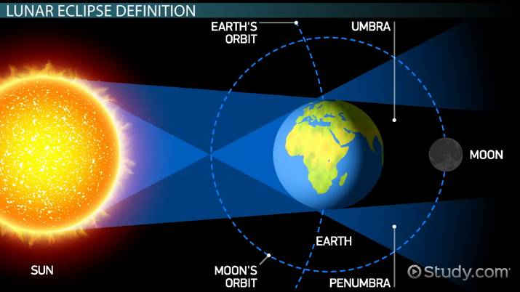

Slide 26
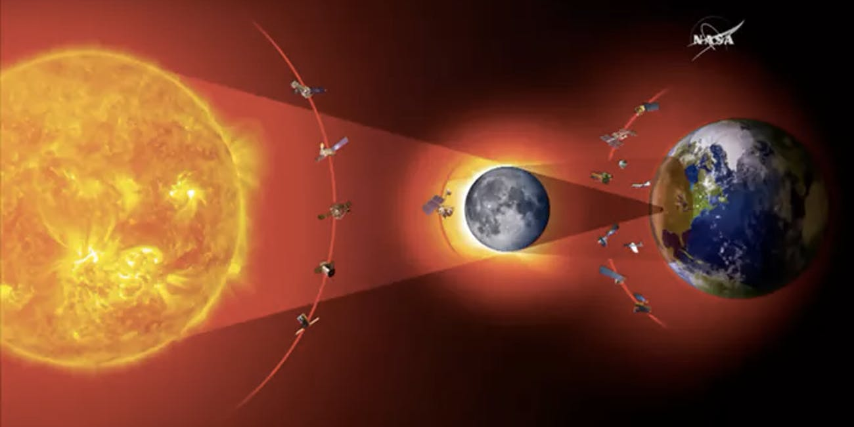

Slide 27
Revelation 1:20 The mystery of the seven stars which thou sawest in my right hand, and the seven golden candlesticks. The seven stars are the angels of the seven churches: and the seven candlesticks which thou sawest are the seven churches.

Slide 28
The Principles of the Vision
It is to open the eyes of lost men
It is to turn men from darkness to light
It is to turn men from the power of Satan unto the Power of God
2

Slide 29
Romans 1:20 For the invisible things of him from the creation of the world are clearly seen, being understood by the things that are made, even his eternal power and Godhead; so that they are without excuse:

Slide 30
Romans 5:6 For when we were yet without strength, in due time Christ died for the ungodly.

Slide 31
Ephesians 2:12 That at that time ye were without Christ, being aliens from the commonwealth of Israel, and strangers from the covenants of promise, having no hope, and without God in the world:

Slide 32
2 Timothy 2:26 And that they may recover themselves out of the snare of the devil, who are taken captive by him at his will.

Slide 33
The Principles of the Vision
It is to open the eyes of lost men
It is to turn men from darkness to light
It is to turn men from the power of Satan unto the Power of God
It is so that men receive the forgiveness of sins
2

Slide 34
Acts 26:18 To open their eyes, and to turn them from darkness to light, and from the power of Satan unto God, that they may receive forgiveness of sins, and inheritance among them which are sanctified by faith that is in me.

Slide 35
Galatians 3:26 For ye are all the children of God by faith in Christ Jesus.

Slide 36
The Principles of the Vision
It is to open the eyes of lost men
It is to turn men from darkness to light
It is to turn men from the power of Satan unto the Power of God
It is so that men receive the forgiveness of sins
It is so that men might receive an inheritance
2

Slide 37
Ephesians 1:18 The eyes of your understanding being enlightened; that ye may know what is the hope of his calling, and what the riches of the glory of his inheritance in the saints,

Slide 38
The People of Vision
3

Slide 39
The People of Vision
Desire doesn’t constitute a call
3

Slide 40
Romans 9:1-3 I say the truth in Christ, I lie not, my conscience also bearing me witness in the Holy Ghost, 2 That I have great heaviness and continual sorrow in my heart. 3 For I could wish that myself were accursed from Christ for my brethren, my kinsmen according to the flesh:

Slide 41
Acts 9:15 But the Lord said unto him, Go thy way: for he is a chosen vessel unto me, to bear my name before the Gentiles, and kings, and the children of Israel:

Slide 42

Do you have
God’s vision?

Slide 43
Have you been obedient?

Slide 44
Will we be able to say…
“I’ve finished my course?”

